Slide 1
Weekly Report (AI based motion control)
Jin Lexuan
1.10.2021

Slide 2
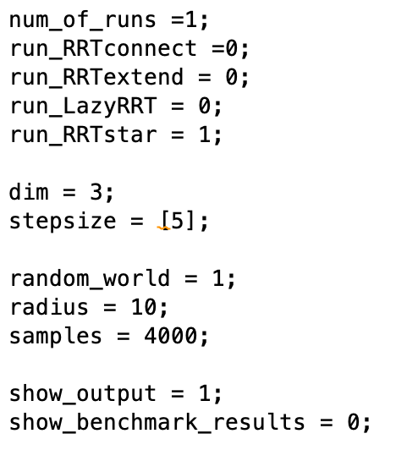
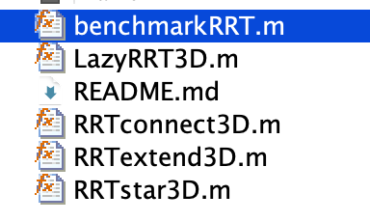
3D RRT Path Planning Code of Matlab
Running times and type of RRT can be decided
dimension of map can be 2D or 3D
Obstacles can be random or programmed

Slide 3
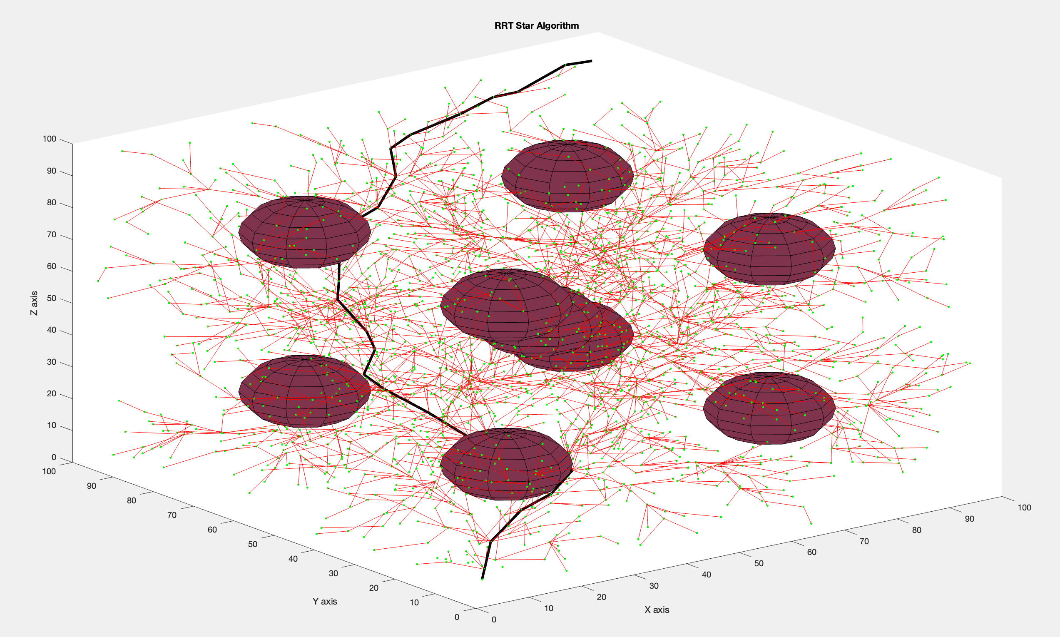
Code Result Presentation
RRT* Algorithm by programmed
obstacles

Slide 4
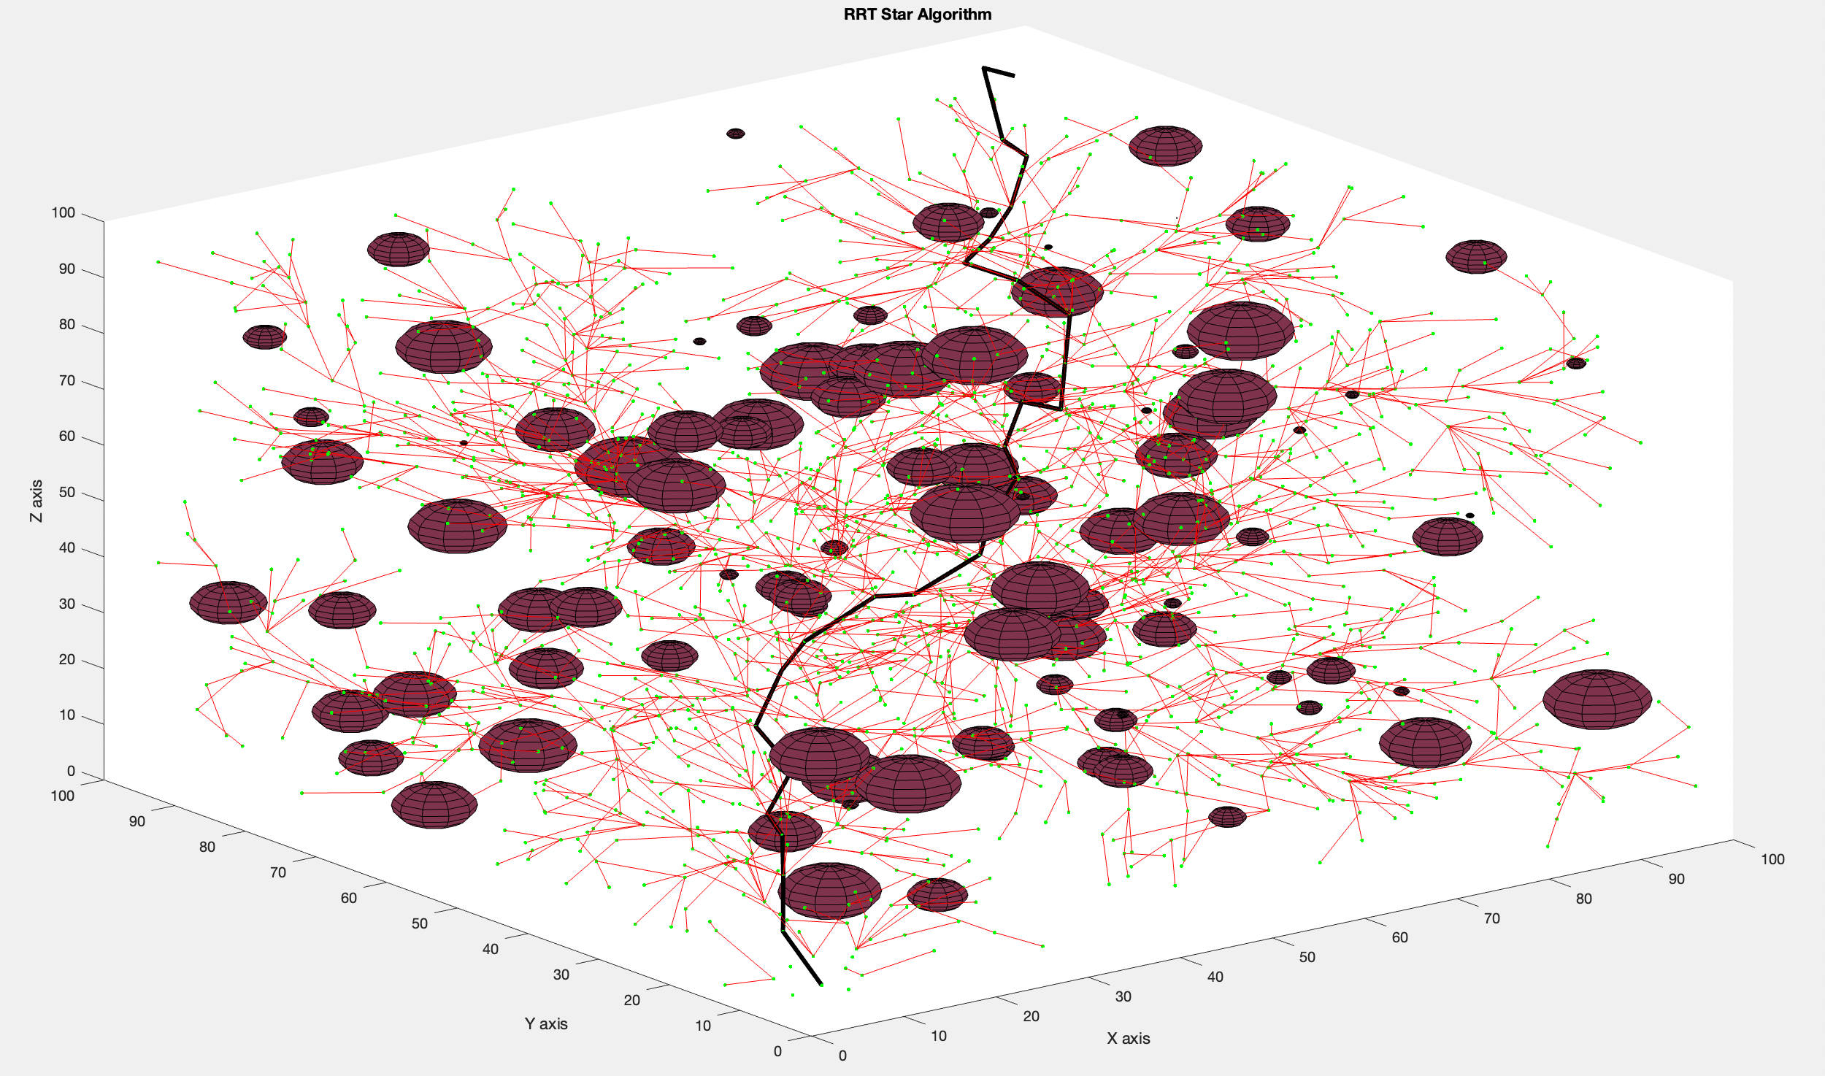
Code Result Presentation
RRT* Algorithm by random obstacles

Slide 5

Transfer path to trajectory
Position $θ(t)=c_{0}+c_{1}t+c_{2}t^{2}+c_{3}t^{3}$
Speed $v(t)=c_{1}+{2c}_{2}t+3c_{3}t^{2}$
Accelaration $a(t)=2c_{2}+6c_{3}t$
Boundary conditions
derivation
 | Position | Velocity
t=0 | a | 0
t=T | b | 0

Slide 6
Future work
Improve the 3D map(based on the code,change the size of map, try different size and shape of obstacles)
Extract the path from RRT result
Divide the path into smooth curve
Calculate the coefficient of polynomial to fit the curve
(path to trajectory)

Slide 7
Thank you for listening!

